Slide 1







Slide 2
EMOTIONS

Slide 3

Review on prediction of Emotion Recognition through Computer Vision and Deep Learning
Submitted by:
Vinayak Kumar Singh (23MCA1030)
Khan Mohammed Raza (23MCA1029)
Shivanand Thakur (23MCA1012)
Submitted To :
Dr.Rashmi Rekha Borah
Assistant professor VIT,Chennai.

Slide 4
Introduction
Emotion recognition is the process of identifying and understanding human emotions.
Emotion recognition through facial recognition is a captivating and interesting domain within artificial intelligence and computer vision.
Emotion recognition helps us to better understand and interact with one another in an increasingly digital world.

Slide 5
Objectives
To Enhance Human-Computer Interaction
To Improve Real-time Emotion Recognition
To evaluate the real-world applicability of emotion recognition in healthcare for early mental health diagnosis.
To develop user-friendly applications that utilize emotion recognition technology for enhancing human-computer interactions.

Slide 6
Argument
How can emotion recognition models be made more robust and adaptable to varying lighting conditions and image qualities?
How can emotion recognition be integrated into user-friendly applications to enhance human-computer interactions and user experiences?
Can facial expression recognition contribute to improving mental health diagnosis, and what are the potential challenges in its application in the mental health field?

Slide 7
Methodology
Collecting a dataset of images or videos with emotions.
Detecting faces in the data.
Identifying facial landmarks.
Extracting features using deep learning .
Training a model to classify emotions

Slide 8


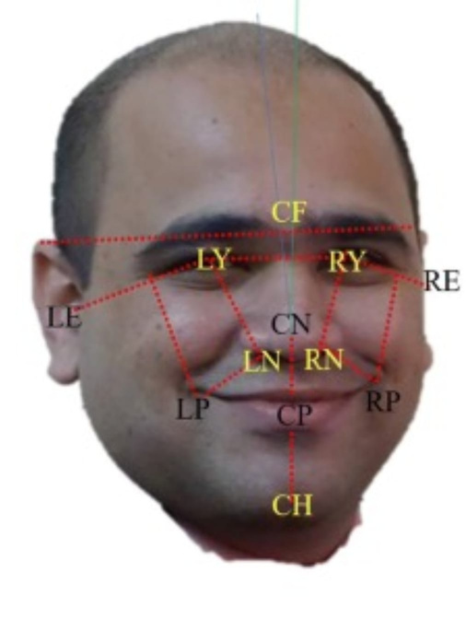

Slide 9


Slide 10
Efficient Facial Expression Recognition Algorithm Based on Hierarchical Deep Neural Network Structure
Author:- JI-HAE KIM , BYUNG-GYU KIM , PARTHA PRATIM ROY
(2019)
The paper uses a computer method to understand emotions from facial expressions by looking at how faces appear and move.
The main aim of the paper is to make emotion recognition from faces better. It succeeds with a 98.3% accuracy rate on the CK+ dataset.
Attention Mechanism-based CNN for Facial Expression Recognition
Author:- Jing Li, Kan Jin, Dalin Zhou, Naoyuki Kubota
(2020)
This paper uses an end-to-end network with attention mechanisms and LBP features for facial expression recognition.
The main objective is to improve accuracy in recognizing facial expressions by combining deep learning and attention mechanisms, addressing traditional method limitations.

Slide 11
Emotion Recognition of Students Based on Facial Expressions in Online Education
Author:- Fanzhi Kong
(2020)
The paper introduces a real-time emotion analysis framework for online education using deep learning and computer vision.
It addresses limitations and proposes enhancements like better preprocessing, advanced models, and regular updates for continued competitiveness.
Facial emotion identification using convolutional neural networks (CNN)
Author:- Ninad Mehendale
(2022)
This paper primarily compares different methods and approaches to Emotion Recognition in Conversation.
The main objective is to highlight challenges and suggest future directions to improve dialogue systems by incorporating emotional understanding.

Slide 12
Human Emotions identification with help Internet of Things
Author:- Wentao Hua, Fei Dai, Liya Huang, Jian Xiong, and Guan Gui
(2019)
The paper employs an ensemble deep learning algorithm with sub-networks using CNNs for facial emotion identification.
The paper aims to enhance emotion identification in IoT by outperforming existing methods through deep learning and ensemble techniques.
Facial Expression Identification using Convolutional Neural Network with Data Augmentation
Author:- Tawsin Uddin Ahmed, Sazzad Hossain and Mohammad Shahadat Hossain
(2019)
This paper uses a Convolutional Neural Network (CNN) with data augmentation to enhance facial expression recognition.
The main objective of this paper is to identify limitations in existing old facial expression recognition systems, propose solutions to overcome these limitations, and develop a more efficient model.

Slide 13
A real time face emotion classification and recognition using deep learning model.
Author:- Dr. Shaik Asif Hussain, Ahlam Salim Abdallah Al Balushi
(2020)
The paper employs Haar cascade detection, Viola-Jones algorithm, and CNN for real-time face emotion recognition.
Its main objective is precise classification of emotions like sadness, anger, happiness, and disgust using deep learning for real-time processing.
A Gesture-to-Emotional Speech Conversion by Combining Gesture Recognition and Facial Expression Recognition
Author:- Peiwen Wu, Hongwu Yang, Peiwen Wu
(2019)
The paper employs sign language and facial expression recognition to synthesize emotional speech.
The main objective is to enhance communication for those with speech disorders by converting sign language and facial expressions into emotional speech.

Slide 14
Reference
Kim, J. H., Kim, B. G., Roy, P. P., & Jeong, D. M. (2019). Efficient facial expression recognition algorithm based on hierarchical deep neural network structure. IEEE access, 7, 41273-41285.
Li, J., Jin, K., Zhou, D., Kubota, N., & Ju, Z. (2020). Attention mechanism-based CNN for facial expression recognition. Neurocomputing, 411, 340-350.
Wang, W., Xu, K., Niu, H., & Miao, X. (2020). Emotion recognition of students based on facial expressions in online education based on the perspective of computer simulation. Complexity, 2020, 1-9.
Mehendale, N. (2020). Facial emotion recognition using convolutional neural networks (FERC). SN Applied Sciences, 2(3), 446.
Jabar, M. K., & Al-Qurabat, A. K. M. (2021, May). Human activity diagnosis system based on the internet of things. In Journal of Physics: Conference Series (Vol. 1879, No. 2, p. 022079). IOP Publishing.
Ahmed, T. U., Hossain, S., Hossain, M. S., ul Islam, R., & Andersson, K. (2019, May). Facial expression recognition using convolutional neural network with data augmentation. In 2019 Joint 8th International Conference on Informatics, Electronics & Vision (ICIEV) and 2019 3rd International Conference on Imaging, Vision & Pattern Recognition (icIVPR) (pp. 336-341). IEEE.

Slide 15

Thank you!

